Slide 1

Track3

Slide 2
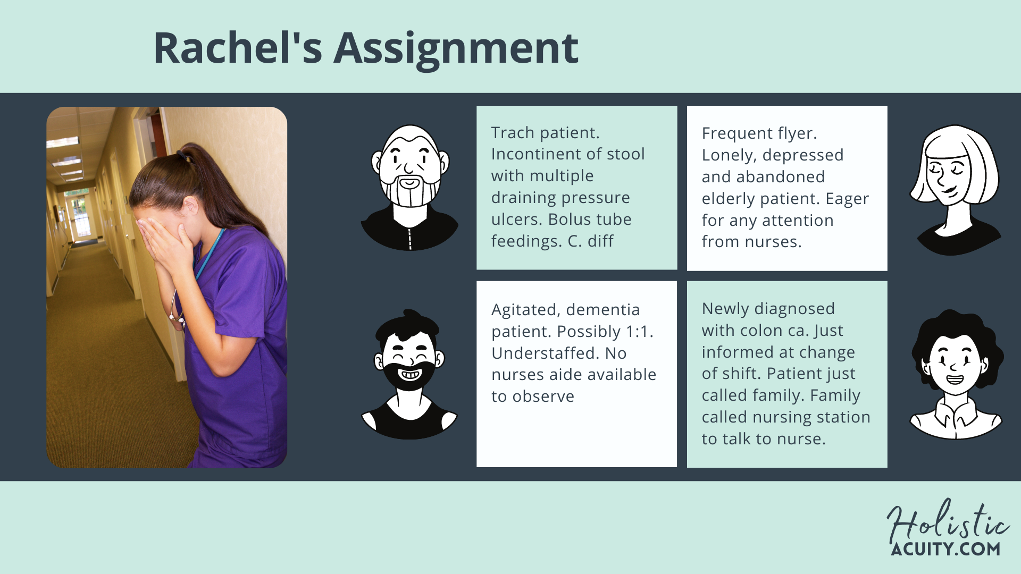
Track3
Notes:
30 Seconds: Reflection on patient acuities.
Good morning, everyone, my name is Rachel. I am a nurse in New York. I am currently in a masters’ program for informatics to get far away from bedside. I want to quit bedside nursing because of my typical workday. In my four patients. One is extremely heavy, trached, incontinent, tube feedings, and now on isolation and next one is going to be attention seeking, lonely, depressed elderly patient eager to talk. Also, got a fall risk that is going to be consistently jumping out of bed and talking to this one’s family is going to be emotionally draining. Why is the team balanced this way? Can’t the team be split more by the acuity level? Not only medically but by psychosocial factors too?
1:4 nurses ratio; 15 minutes per patient per hour

Slide 3
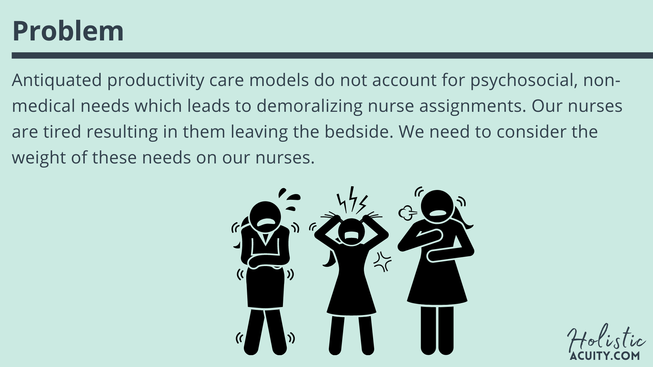
Track3
Notes:
As a charge nurse, I face this problem: Antiquated productivity care models do not account for psychosocial, non-medical needs which leads to demoralizing nurse assignments. Our nurses are tired. They are leaving the bedside. We need to consider the weight of these needs on our nurses.
We are facing an industry nurse exodus. We can start small and reach for standardized, fair assignments.

Slide 4
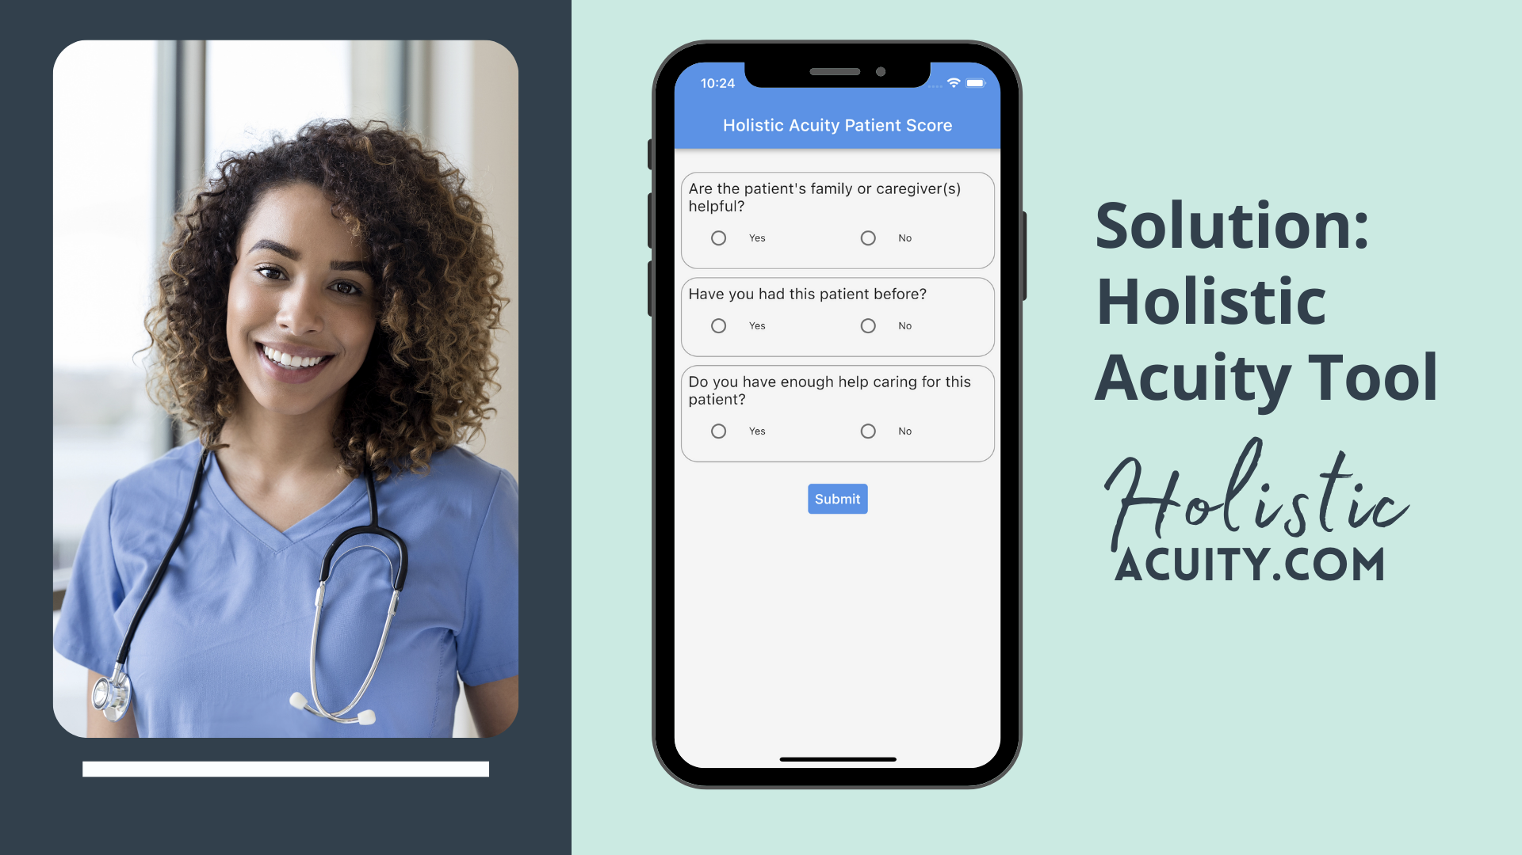
Track3
Notes:
Here's our solution. The Holistic Acuity Score. We built the Holistic Acuity Score to address this problem. Through nurse feedback and weighted measures, we provide charge nurses and hospital administration a holistic acuity score to help balance nurse assignments.
In order to prevent compassion fatigue and burnout in our nursing workforce, we need technology tools that account for non-medical issues in patient care delivery. Our solution is the development of an electronic key-value tool that will consider three variables, helpfulness of family/caregiver, familiarity with patient, and delegable tasks. These are untapped variables in patient acuity however they account for our human engagement in patient care.
Through these three variables we are creating the Holistic Acuity Score, an electronic key-value tool that assists charge nurses with assignment allocation for bedside nurses. We cannot address the medical acuities alone but need to account for our patients as a whole.
BENEFIT: Charge nurse makes assignment balanced between medical and holistic standpoint.
Check it out at www.holisticacuity.com

Slide 5
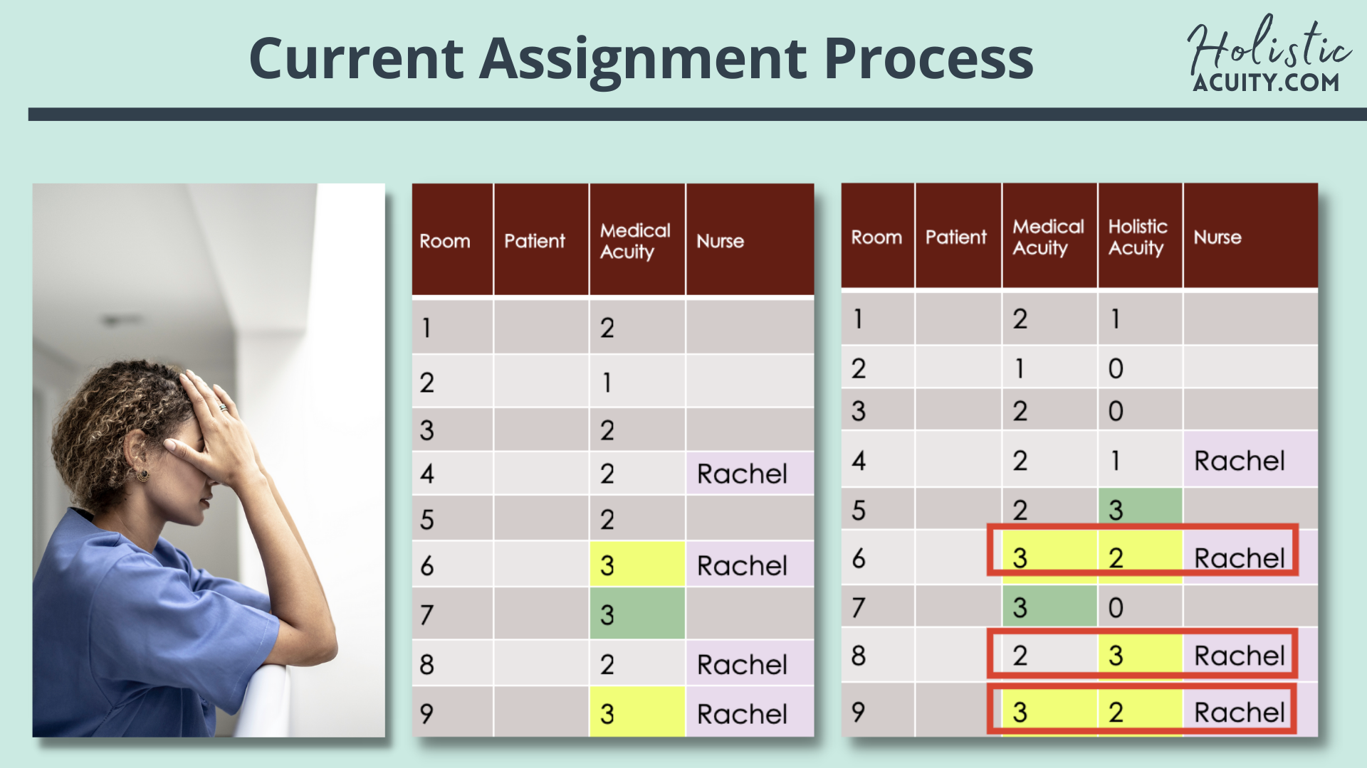
Track3
Notes:
Looking at the Holistic Acuity Score in action, Rachel's assignment was unbalanced. An informed charge nurse would have adjusted her assignment. Rachel and many other nurses would not be leaving the bedside.

Slide 6
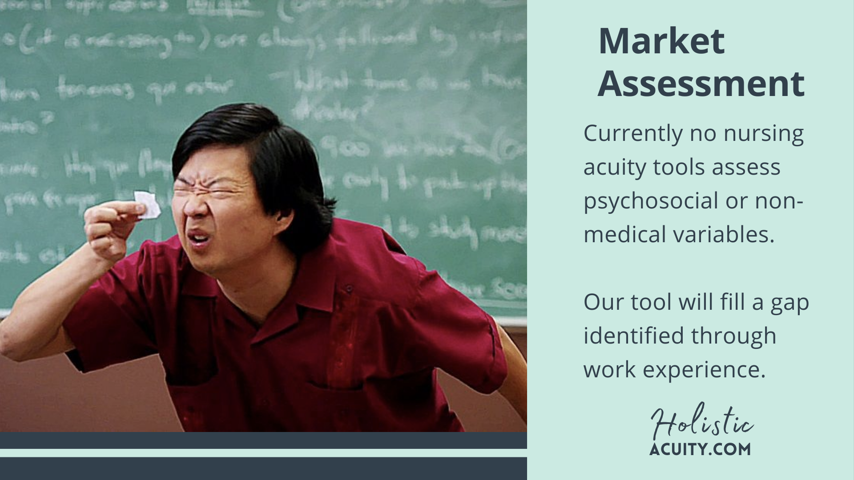
Track3
Notes:
Our Marketplace Assessment acknowledges productivity acuity tools. However, a nursing acuity tool assessing psychosocial or non-medical variables does not exist. The Holistic Acuity Tool will fill this gap.
(emptiness, inadequateness)

Slide 7
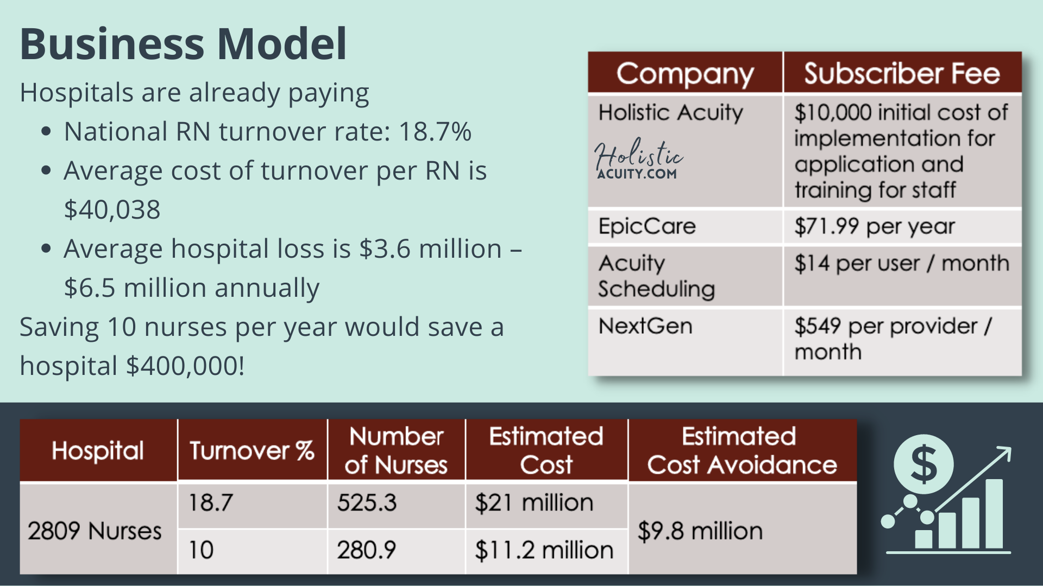
Track3
Notes:
Hospitals are paying a price due to nurse turnover.
The average cost of turnover per RN is $40,000, costing up to $6.5 million annually.
In a case study of my hospital of employment, we would loose 525.3 nurses at 18.7%. Decreasing nurse turnover to 10% would save the hospital an estimated $9.8 million annually.

Slide 8
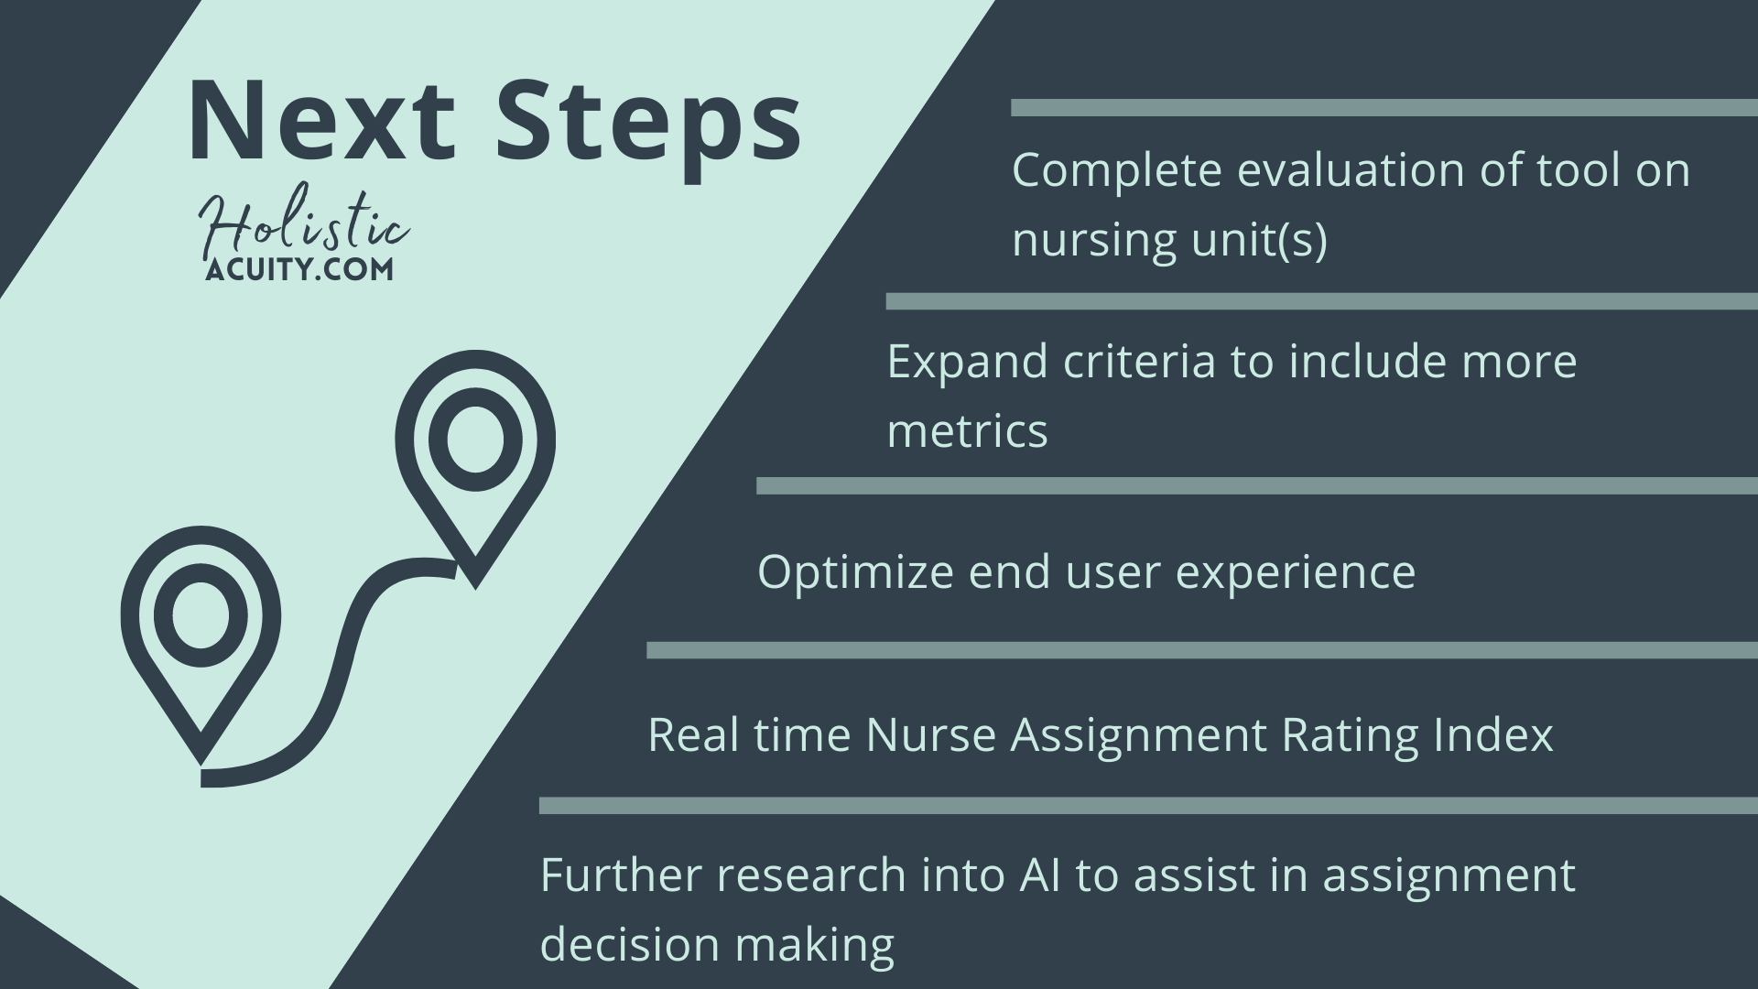
Track3
Notes:
The Holistic Acuity Tool is our initial footprint. It needs to undergo validity and reliability testing. We know we will need to work out the kinks with the end users. We believe in real-time nurse feedback, and we want to invest in the machine learning for assistive decision making.

Slide 9
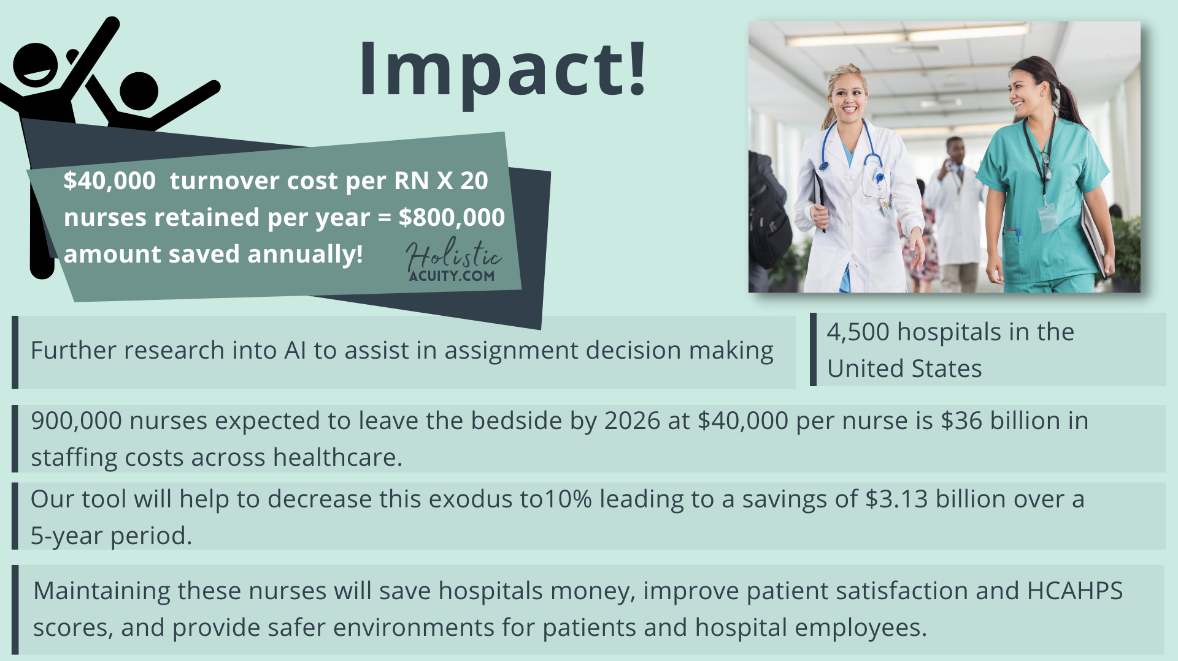
Track3
Notes:
-The missing piece to balanced staffing is the Holistic Acuity Tool. We believe this tool will help to decrease disengagement by staff and improve retention.
-If we save 20 nurses from leaving annually, it will save your hospital $800,000 each year, more than sufficiently covering the cost of our tool.

Slide 10
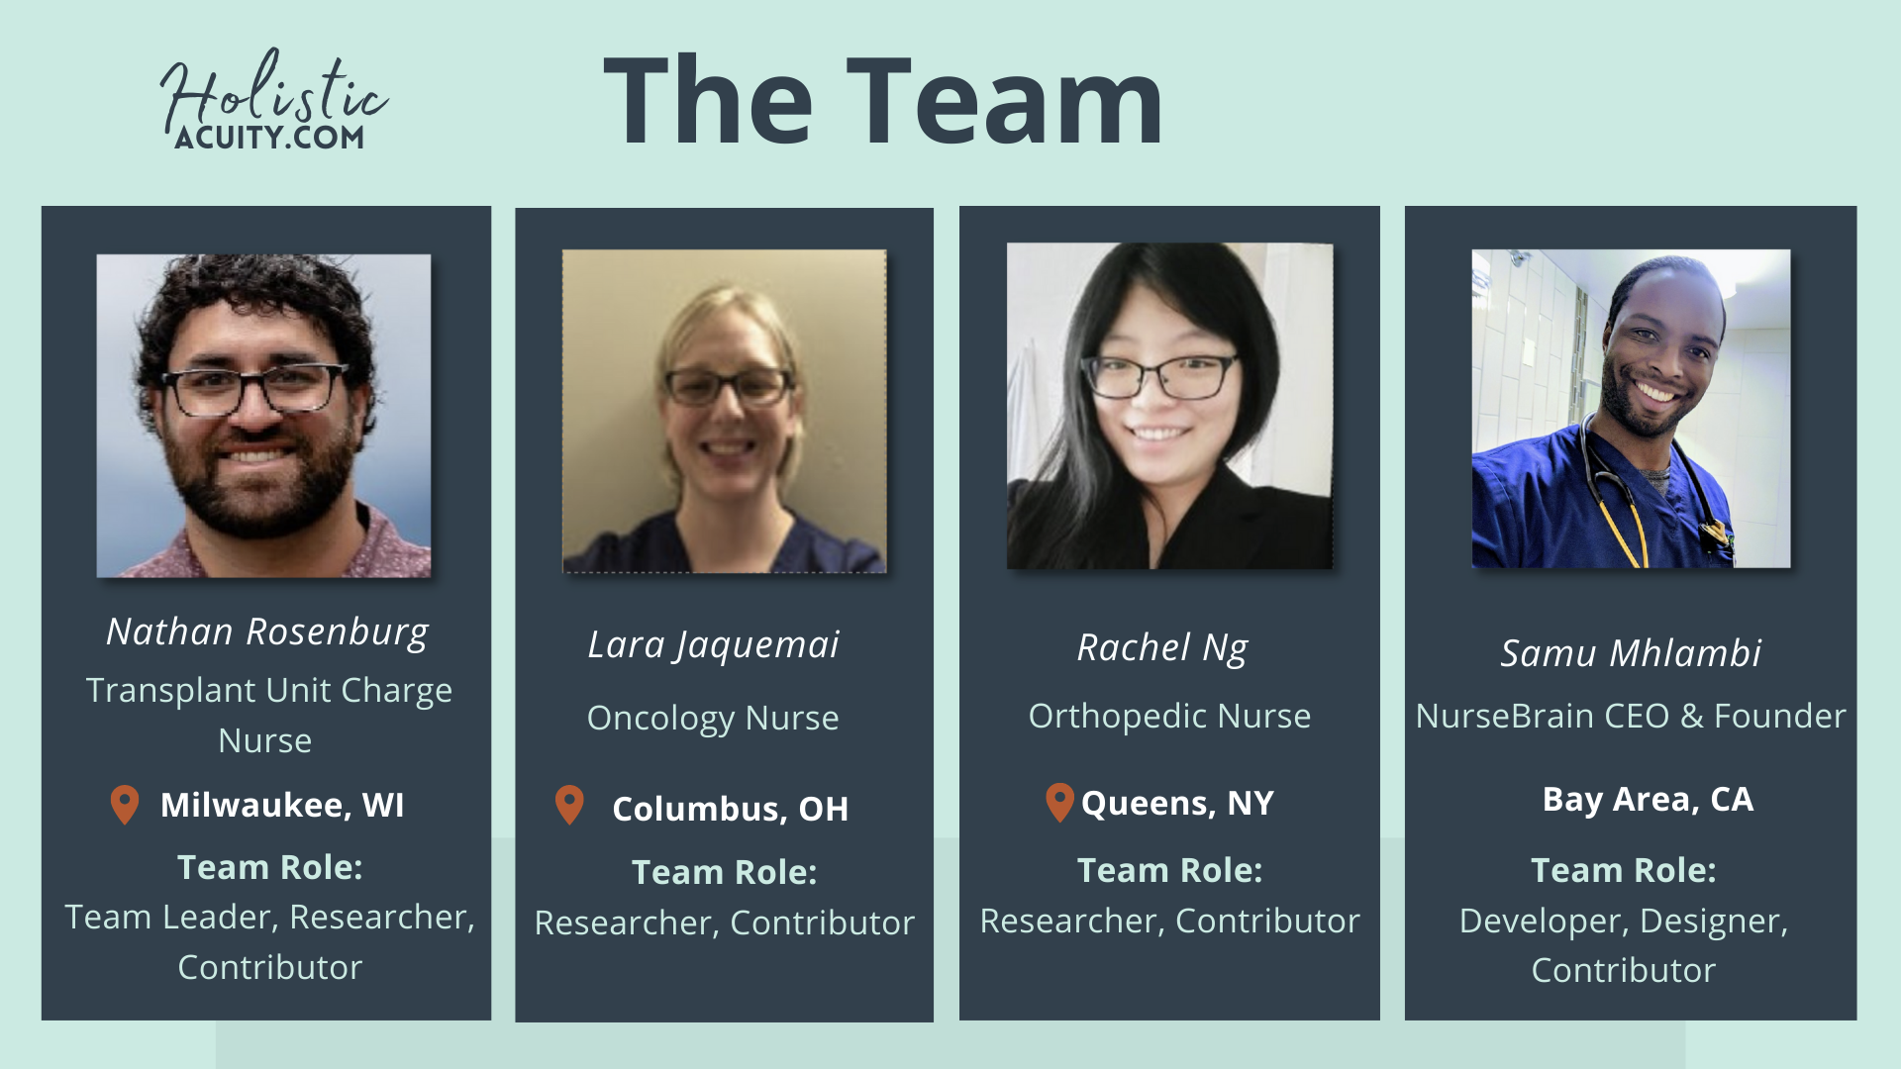
Track3
Notes:
Bring the story you opened with full circle.
Close the pitch– why do you think this is a great idea? Remind the audience what they have seen – no more than three points.
Introduce your team members and discuss skill sets brought to the team that strengthens the solution. By now the audience understands your proposed solution so they can connect the skill sets. Include contact Info: Name/Email
Many investors will invest if they like the team and find the team inspiring and passionate.
Try to anticipate the judges questions so you can answer them, however, if you have done your homework, you will be prepared.
Finally, practice, practice, practice! Getting all important points across in 3 minutes!

